Slide 1


Shri Vaishnav Institute of Management, Indore
APPROVED BY AICTE, NEW DELHI & AFFILIATED TO DAVV, INDORE and RGPV, Bhopal (M.P) UGC-NAAC ACCREDITED ‘A’ GRADE INSTITUTE
MCA 306 Minor Project
Business Web App
Guided by:- Submitted by:-
Ms. Ratnalata Gupta Abhishek Buliwal
Ishan Jaiswal

Slide 2
Index
What is BuliWear
Need of BuliWear
What BuliWear can do
Technology used
Why MERN Stack
System Requirement
First Look
Conclusion

Slide 3
What is BuliWear
BuliWear is a one stop for all of your baby needs. It provides you The Best in Comfort product for your baby. Here you will get clothes and few more products for your baby.
As you will become a part of our BuliWear family we will make sure to provide you our best services and products. And for this we just need your support and feedback.
Become a part of our BuliWear family by simply visiting:-
www.BuliWear.com

Slide 4
Need of BuliWear
The short answer is that there has never been a better or more important time to invest in a website for your business. A website offers a wide variety of benefits for small businesses, and most of these benefits increase in value exponentially year over year, just like the Internet itself.
Our website can attract new customers
We can clearly showcase your products and services
A website can encourage customers to contact us
Our website establishes your place in this industry

Slide 5
What BuliWear can do
Our platform is capable to handle all of our customers needs by providing details about our product and services we offer.
Also we get there some information like Email address by which we can contact them and share a news letters with which has details about new product and services and future updates.
As this is an official website our customers did not have to worry about anything before Signing In.

Slide 6
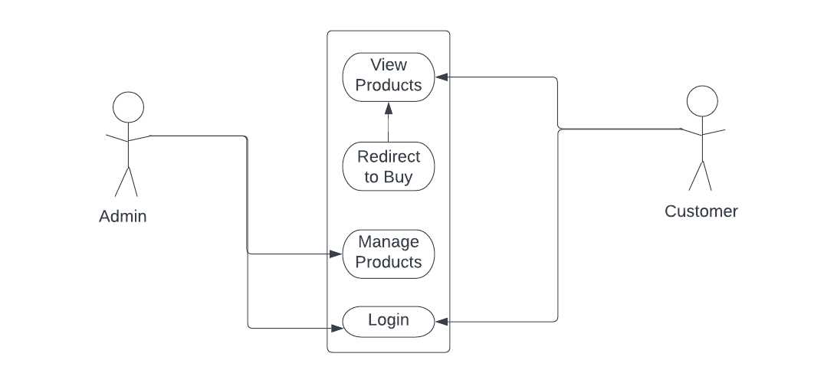
What BuliWear can do

Slide 7
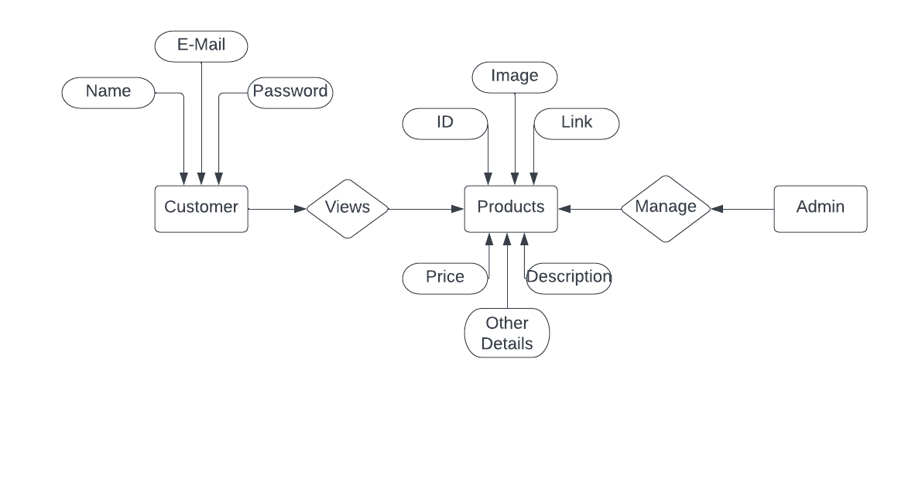
What BuliWear can do

Slide 8
Technology Used
MERN stack is a collection of technologies that enables faster application development. It is used by developers worldwide. The main purpose of using MERN stack is to develop apps using JavaScript only. MERN stands for MongoDB, Express, React, Node, after the four key technologies that make up the stack.
• MongoDB - document database
• Express - Node.js web framework
• React - a client-side JavaScript framework
• Node - the premier JavaScript web server

Slide 9
Why MERN Stack
You could use the MERN stack to create any application you want, just like any other stack. However, it is best suited for cloud-native, JSON-heavy applications that require dynamic web interfaces, such as workflow management, interactive forums, and social products.
MERN provides an end-to-end development environment
Model View Controller (MVC) architecture is supported
MERN comes with testing tools
React is useful for creating interactive HTML UIs and interacting with remote servers

Slide 10
System Requirement
HARDWARE INTERFACES: -
• Memory minimum of 4 GB RAM
• Hard disk of 1 GB
• Processor – Pentium 4 or higher
• Stable Internet Connection
SOFTWARE INTERFACES: -
• Web Technologies – Node JS, React JS
• Database – MongoDB
• Operating System – 7/8/10/11
• Installation – React, MongoDB Compass
• Setup – Node Module

Slide 11
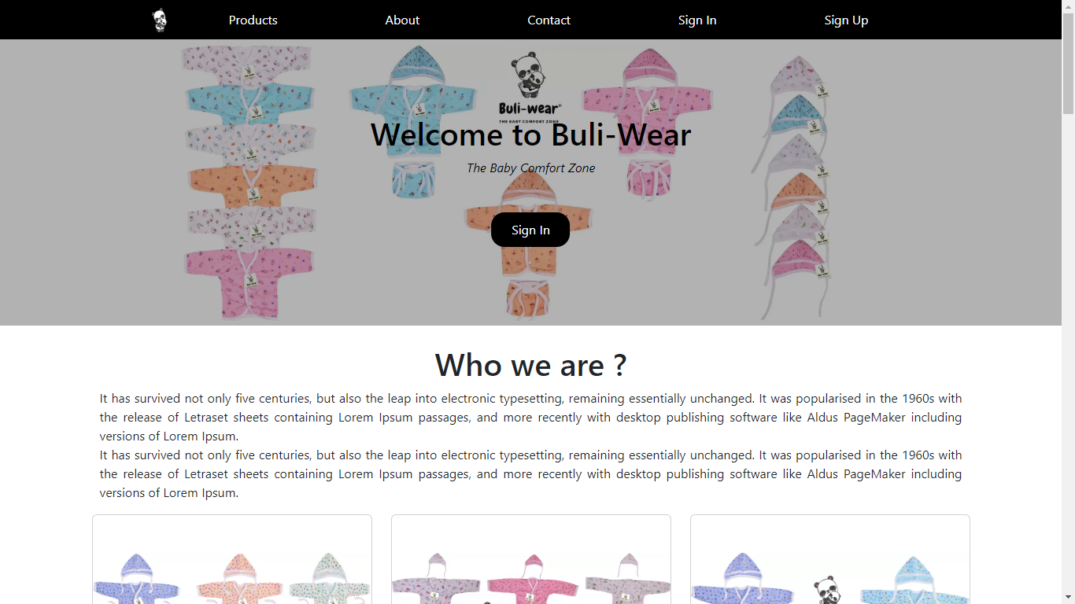
First Look

Slide 12
Conclusion
Limitations of System
• As it is a basic Business web app it has some basic
features only.
• It is dependent on many node module and sometime it
may cause errors.
• Our system doesn’t provide automatic backup of data.
Scope of Future Enhancements
• More enhanced user dashboard
• Full checkout system for buying products
• Visual enhancement.
• And few minor changes

Slide 13
Thank You for your attention

